Slide 1


Eduembed :
Embedding for Education
Project Review - 2
Under Supervision Of:
Prof. Srinath Srinivas
Anurag Mohanty
By:
Sheetal Agarwal (MT2022109)
Sahil Khatri (MT2022095)

Slide 2
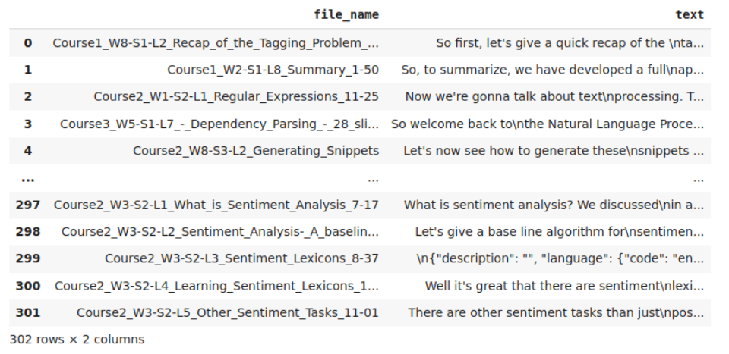
About Project
(Sprint 1 - Code and tech understanding)
Generating custom embeddings for Education/ Academic domain.
Data gathered from online educational platform (Lecture transcript and its metadata).
Data preprocess and extract features/probability score using LDA, NMF, etc.
Using knowledge graphs to represent linguistic context in the form of embeddings.
Notes:
The heart of the knowledge graph is a knowledge model: a collection of interlinked descriptions of concepts, entities, relationships and events. Knowledge graphs put data in context via linking and semantic metadata and this way provide a framework for data integration, unification, analytics and sharing.

Slide 3
Knowledge Graph Embeddings
KG represent diverse types of information in the form of different types of entities connected via different types of relations.
Information extracted from KGs in the form of embeddings is used to improve search, recommend products, and infer missing domain specific context.
Popular KGE models are TransE, TransH, etc. which define different score functions to learn entity and relation embeddings.
Input data for KGE is in the form of triplets (head, relation, tail).
Notes:
It is however hard to train KG embeddings from graphs with millions of nodes and billions of edges.
The vertices of the knowledge graph are often called entities and the directed edges are often called triplets and are represented as a (h, r, t) tuple, where h is the head entity, t is the tail entity, and r is the relation associating the head with the tail entities.

Slide 4

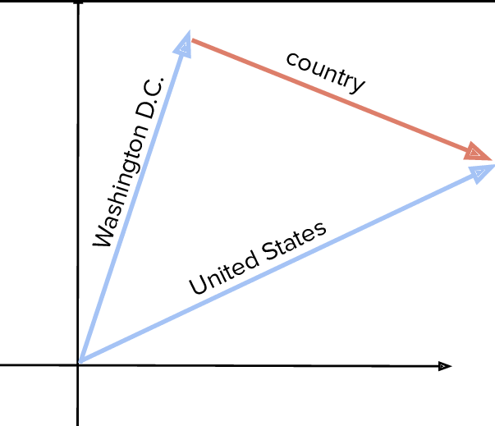
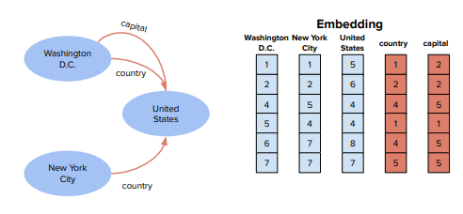
TransE

Slide 5
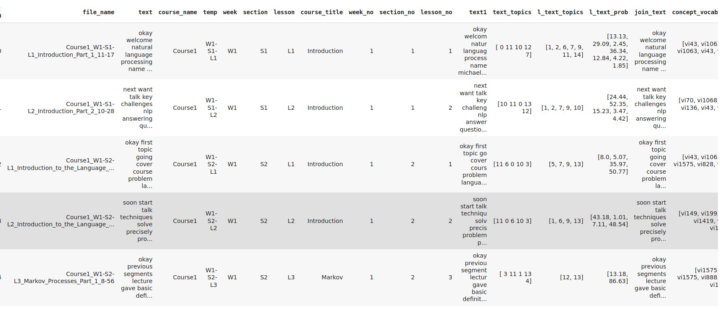
Preprocessing and Feature Extraction
(Sprint 2 - Preprocessing and data formation)

Slide 6
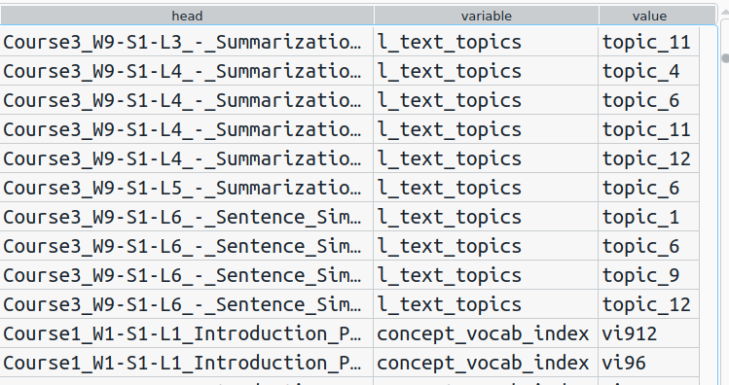
Triplets for Knowledge Graph
(Sprint 3 - Implementation understanding and POC)

Slide 7
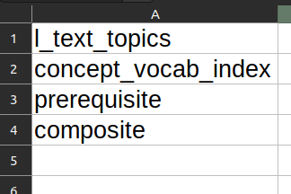
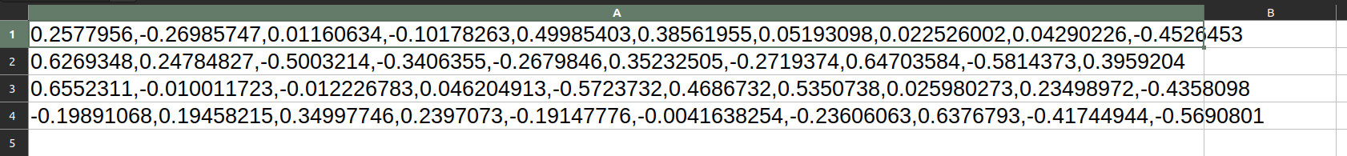
Embedding Generation
(Sprint 4 - TransE with dummy weights and get embeddings)
Generated Embeddings for Entities and Relations
Currently we have 1000+ unique entities
And 4 relations

Slide 8
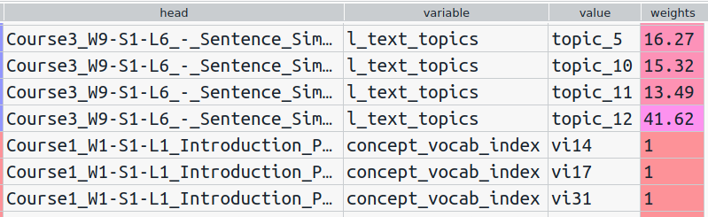
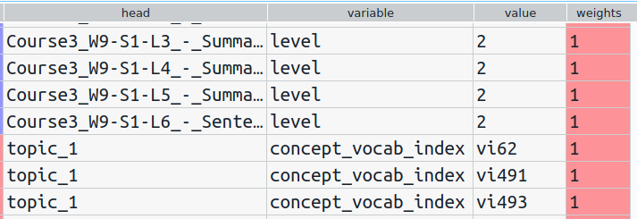
Triples with weights
(sprint 5 - Preparing data with the actual weights)

Slide 9
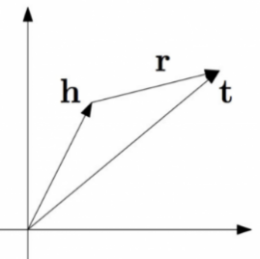
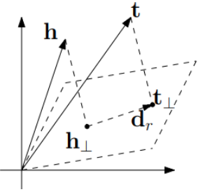
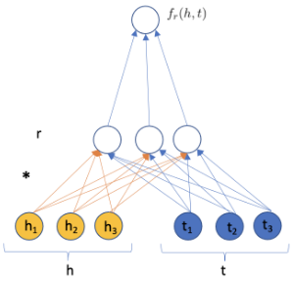
KGE Models
(sprint 6 - Embedding generation using various models)
TransE TransH HolE
Notes:
Trans - translation based model which uses distance based measures to generate the similarity score for pair of entities and their relationships. It maps entities to low dim vector space
TransE - h+r=t. Model fails in case of one to many relation
TransH - was proposed to address the limitations of transE. Head and Tail are projected on relation hyperplane and the further intuition remains similar to transE
Semantic matching based model
HolE - similarity based scoring function
Holographic Embedding
Circular Correlation over tensor product coz it won’t increase dimensionality of the representation

Slide 10
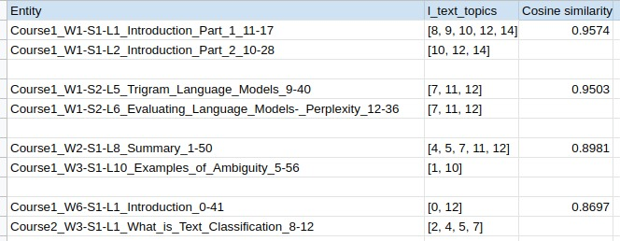
Results
(sprint 6 - Comparing embeddings for cosine similarity)

Slide 11
Scale the weights
(sprint 7 : scaling weights for each relation)
As each relation will have separate meaning associated with their weights, we can not scale weights across all the relations.
Therefore, we first divided the data with respect to relations, and then scaled the weights corresponding to each relation separately.

Slide 12
Split the data with uniformity
(sprint 8 : Train test with uniform distribution)
While splitting the data for training it is advisable to have decent distribution of each category among all the training and test sets.
In our cases we are dealing with the triples which are distinguished based upon the underlying relation.
We have 4 relations (i.e. l_text_topics, concept_vocab_index, prerequisite, level).
We splitted the data evenly for all these relation in order to obtain better embeddings.

Slide 13
Hyperparameter Tuning
(sprint 9 : Evaluating models with different hyper parameters)
As discussed earlier, we are comparing the results for TransE and HolE.
So for fine tuning and finding the best among the 2, we are currently training both the models with different values of hyperparameter.
Metrics that we are evaluating on:
Mr_score - Mean Rank
Mrr_score - Mean Reciprocal Score
Rank_score - Rank of a triple
Hits_at_n_score - Hits@N

Slide 14
Future Plan
Compare the embeddings of TransE and HOlE.
Generate Embeddings using TransH, similar to what we have done for transE.
Include more relations for various entities.
Refine weights to fine tune KGEs.

Slide 15
THANK YOU

